Slide 1
Design and Development of a Communicable Fault Passage Indicator for Low Voltage Distribution Lines in Bangladesh.
Fall 2025 FYDP-P Final Presentation
ATC4
Aban Ahmad (22221072)
Shahriar Ahmed (22221127)
Daiyan Ibnul Aswad (22221012)
Maisha Mahjabin Nidhi (22321071)
ATC Panel Member :
Dr. Mohammed Belal Hossain Bhuian (Chair)
Md. Mahmudul Islam
Sabbir Ahmed

Slide 2
Background Research
Bangladesh’s distribution network experiences technical (10–15%) and non-technical (5–10%) losses despite sufficient generation capacity, indicating inefficiencies at the distribution level. (According to DPDC)
Electricity theft, meter tampering, and undetected faults significantly reduce utility revenue and degrade overall power quality. [2]
Existing fault localization relies on manual patrols and trial-based breaker operations, resulting in 3–4 hour fault identification delays. [1]
Prolonged fault detection contributes to high SAIDI (System Average Interruption Duration Index) values (12–15 hours annually), particularly in rural distribution networks. (DPDC Annual Report 2023-2024)

Slide 3

Stakeholders
DPDC (Primary stakeholder): Verified project feasibility as technically sound & operationally viable.
DESCO: Confirmed complementary distribution network requirements.
JICA Interest: Japan International Cooperation Agency currently in market offering imported fault indicator solutions
JICA pricing: Premium (international standards)
Our Competitive Advantage: Localized solution adapted specifically for Bangladesh distribution networks
Cost reduction: 30–50% cheaper than JICA/international alternatives
Lead time: Months (local procurement) vs. 6–12 months (imports)

Slide 4


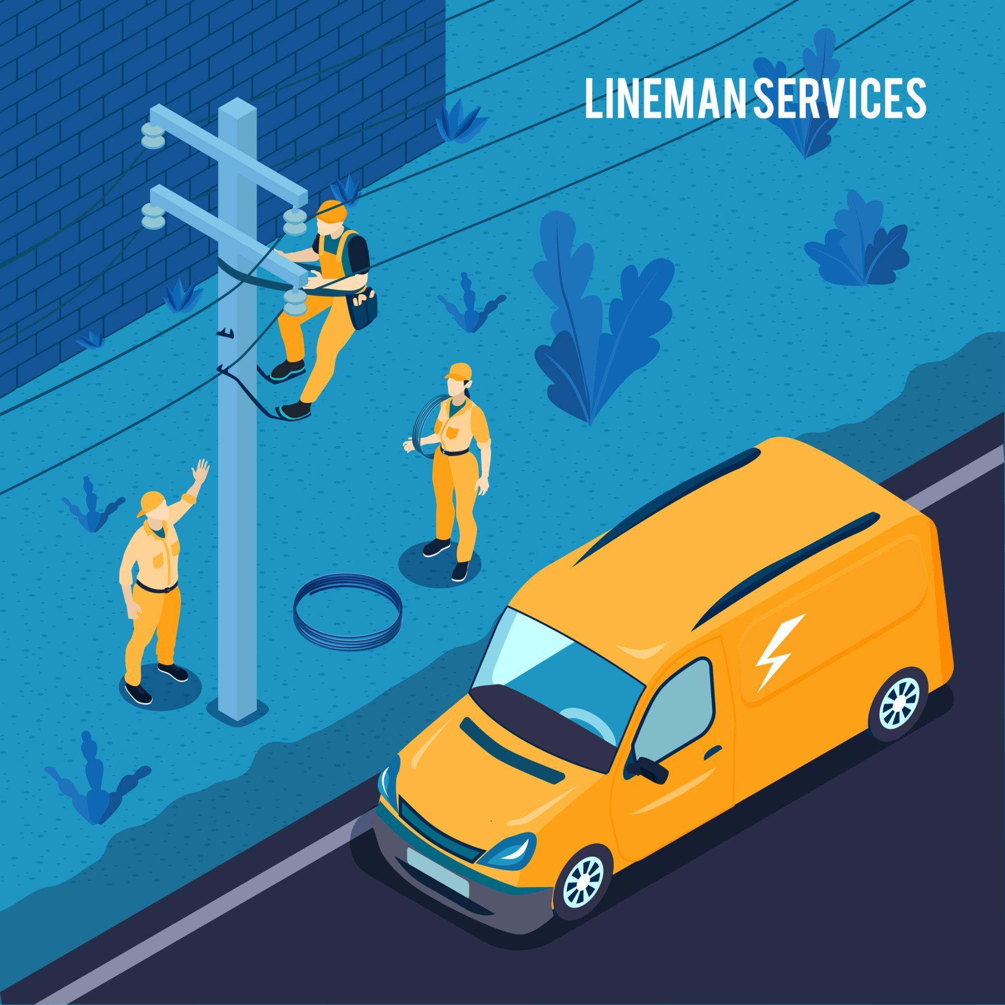
Problem Statement
Distribution companies face excessive outage durations in 11kV networks because conventional fault locating systems fail to accurately locate high-impedance earth faults amid complex laterals and variable loads. This results in manual patrols exceeding regulatory SAIDI limits, inefficient crew dispatches, high ENS costs and penalties. This gap demands precise, adaptive fault sectionalizing.

Slide 5
Objectives
Design and development of an intelligent Fault Passage Indicator (FPI) device with adaptive fault detection algorithms to detect and identify fault currents.
Develop communication capabilities to communicate with the central server.
Validate system’s performance across a range of fault conditions and analyse the obtained data.

Slide 6
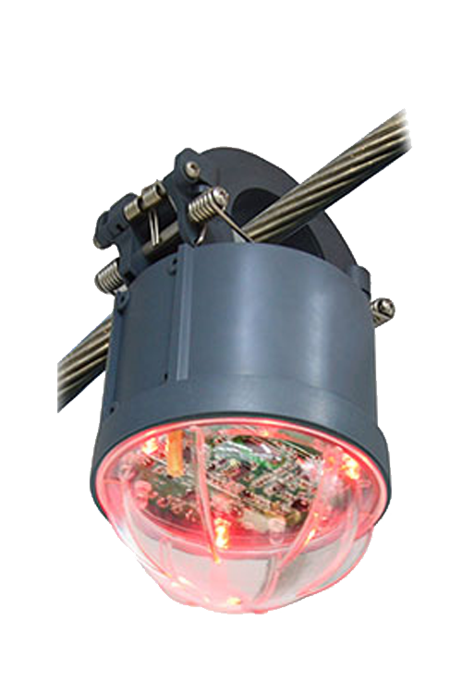
What is Fault Passage Indicator (FPI)?
Detects and signals the passage of a fault in power distribution lines.
Installed on overhead lines to monitor fault conditions.
Provides quick indication for maintenance crews to locate faults.
Helps reduce outage time and improves system reliability.

Slide 7
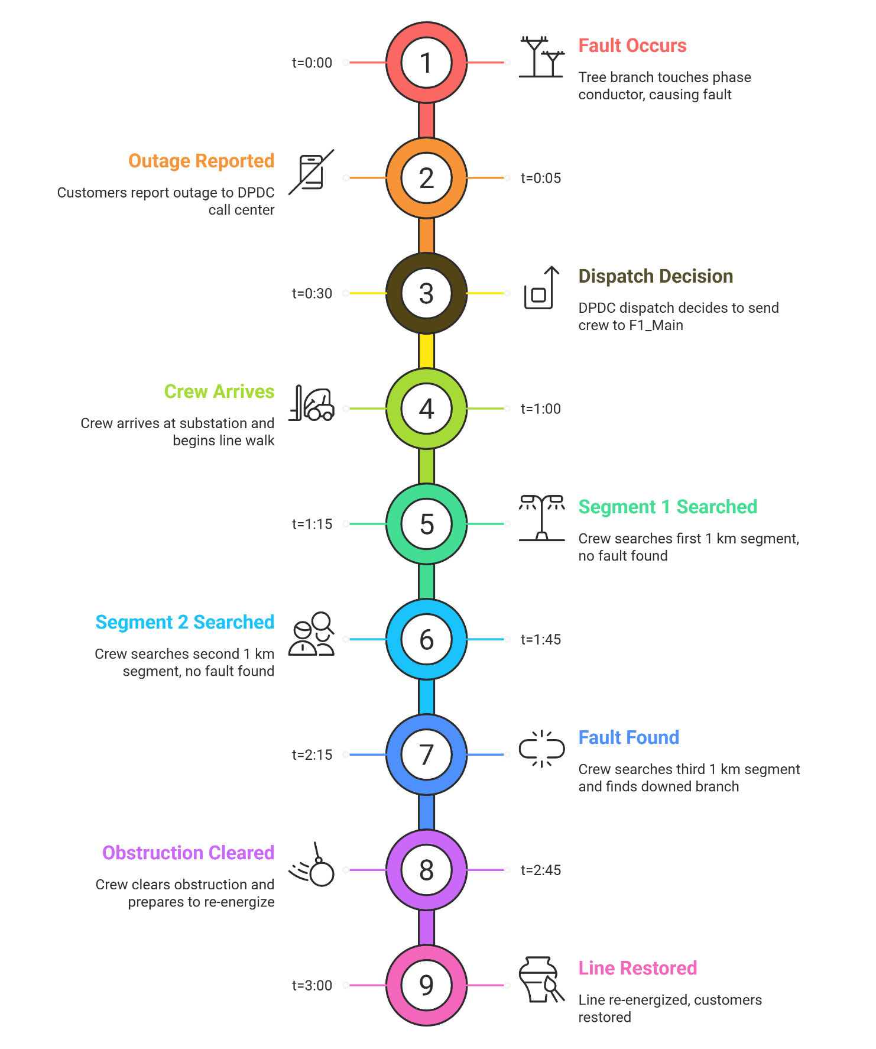
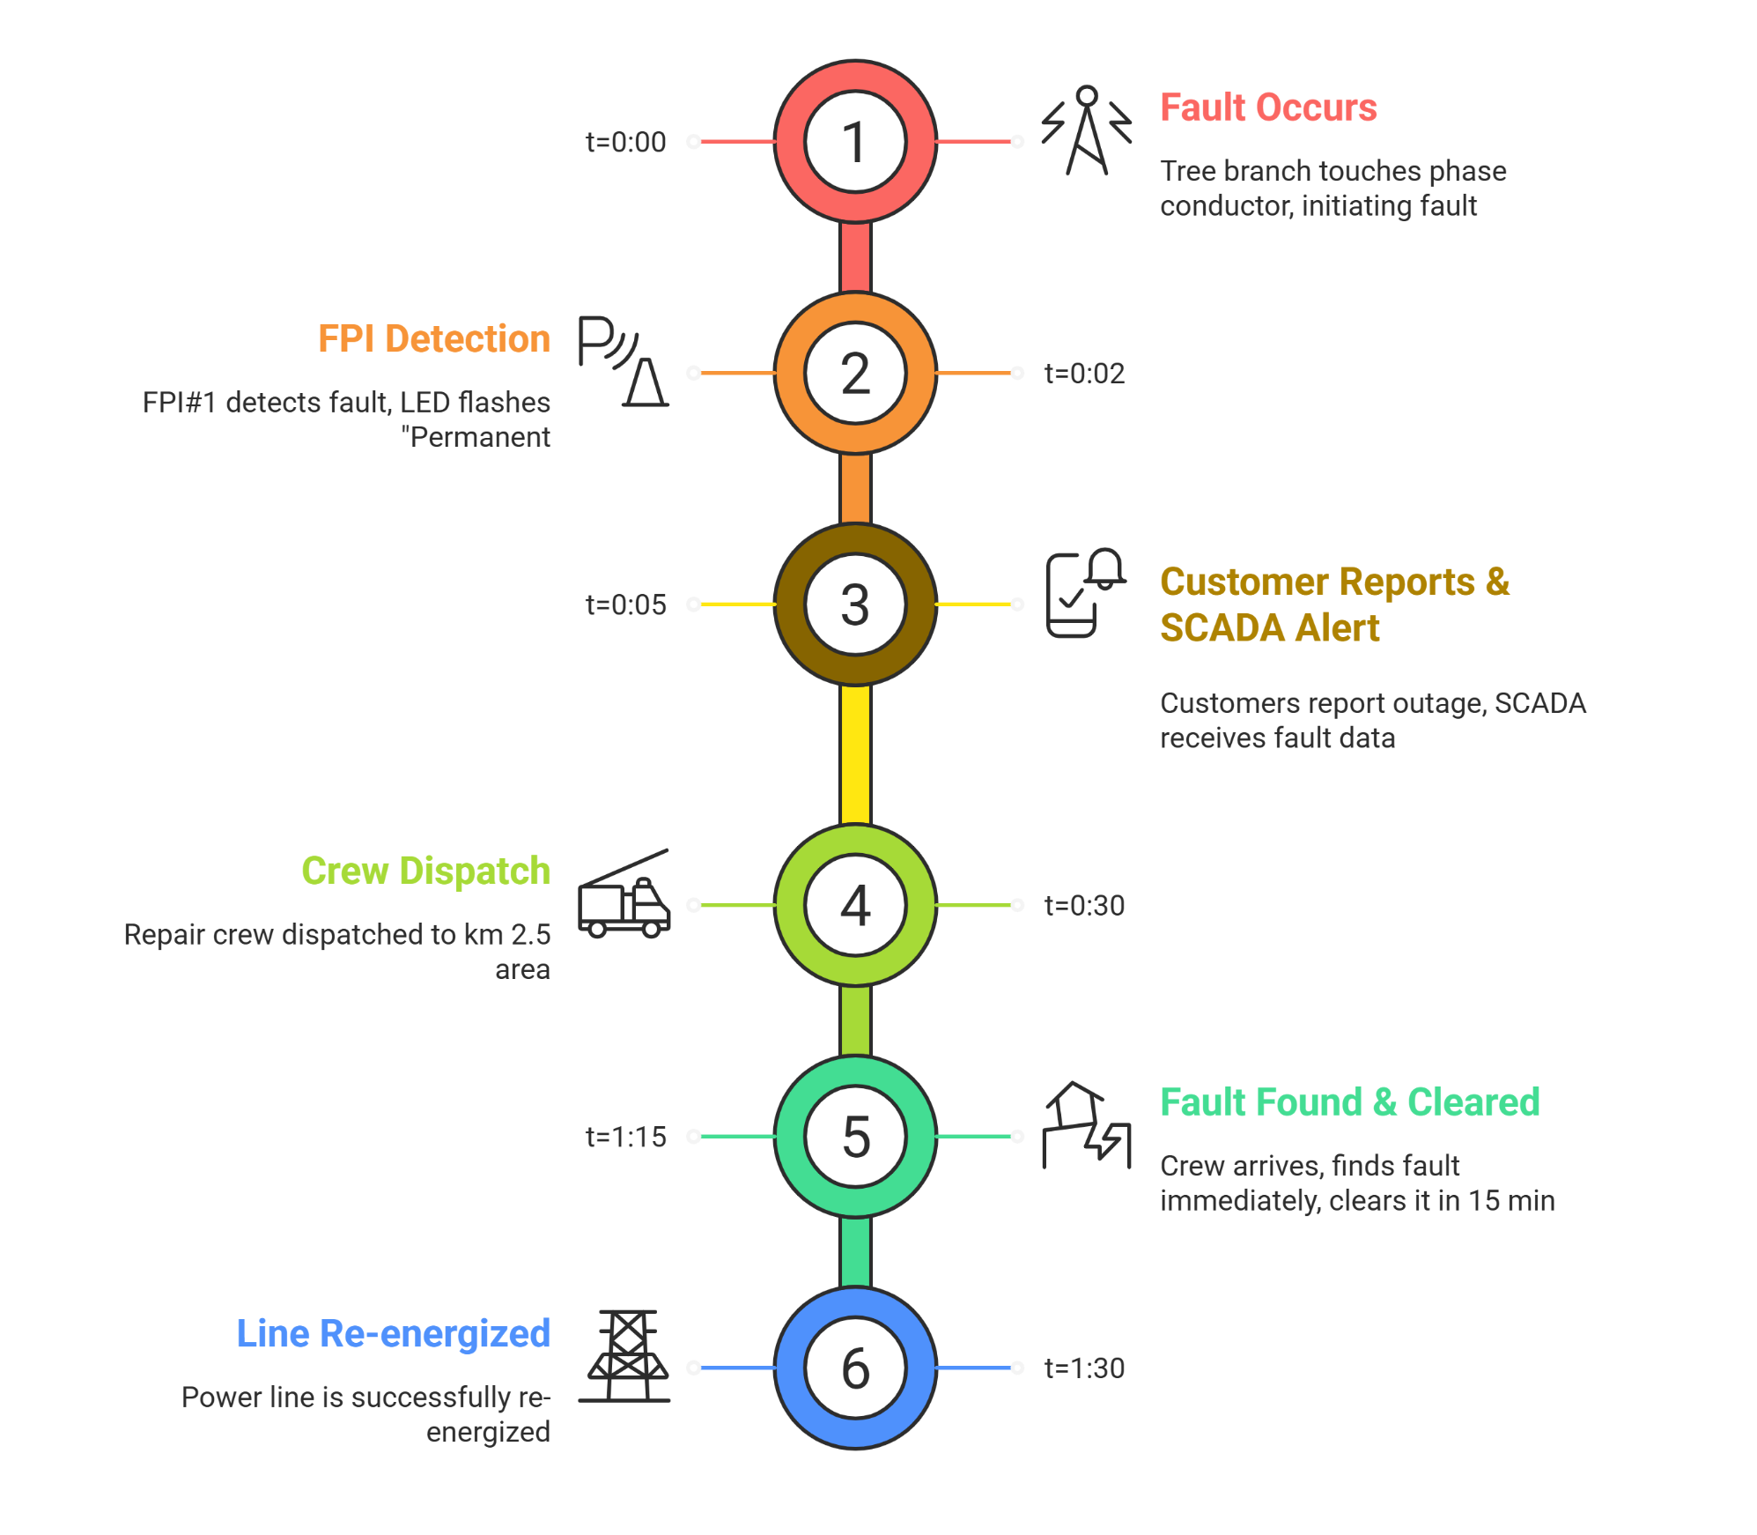
Timeline of system with and without FPI
Normal Fault Location and Repair Timeline
FPI based Fault Location and Repair Timeline

Slide 8
Functional Requirements
01
02
03
04
05
06
Detects fault current and current overflow
Measures Accurate current flow
Sends real time status alerts
Activates and signals the central server
Reduces fault detection identification time
Detects Current theft by comparing the flow of current in between 2 consecutive poles

Slide 9
Non Functional Requirements
Demonstrate detection performance across repeated fault events under identical operating conditions.
The device should be waterproof.
Sends damage signal in case of FPI damage.
The interference is fixed within a system and isn't dynamic .
Detects the type of faults.
Analyses the wire condition.
Efficiency should be above 95%.
Response time should be less than 0.2s to 0.5s.

Slide 10
Constraints
The size and weight of the FPI must not exceed 1 Kg.
The high voltage transmission line Electromagnetic interference must be less than 10 Volts per meter (V/m) around the FPI.
The cost of a single unit of FPI must not exceed a tolerable budget.
The fault must sustain for 40 ms to 100ms.

Slide 11
Project Specifications
Operating conductor supports a 25 mm² copper cable used for current sensing and fault analysis.
System voltage rating operates under laboratory conditions with a maximum operating voltage of up to 440 V.
Current detection range accommodates fault currents in the range of 80 A to 100 A.
Fault sensing duration detects sustained fault current events persisting for more than 5 ms to avoid transient fault misdetection.
Triggering delay activates fault indication within a time window of 0.2 s to 0.5 s after confirmed fault persistence.
Fault detection accuracy would be >90% for identifying fault conditions under controlled test scenarios.
Battery endurance sustains uninterrupted system operation for a minimum duration of 3 years under normal operating conditions.
System reset behavior restores the device to monitoring mode automatically after fault clearance.

Slide 12
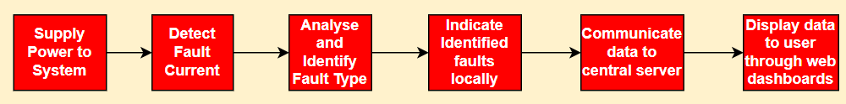
Functional Analysis
Basic Function: Detect, identify, and communicate faults.
Secondary Functions:
Supply power to the system.
Detect fault current.
Analyse and identify fault type.
Indicate identified fault locally.
Communicate data to central server.
Display data to user through web dashboards.

Slide 13
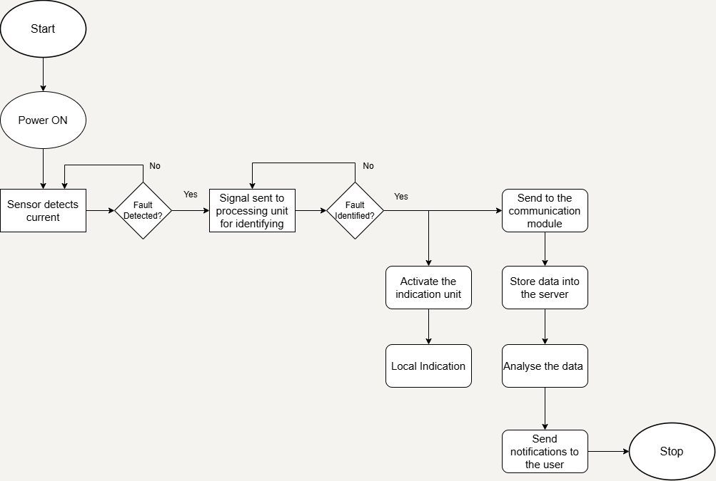
Flowchart
Figure 1: Flowchart of the system

Slide 14
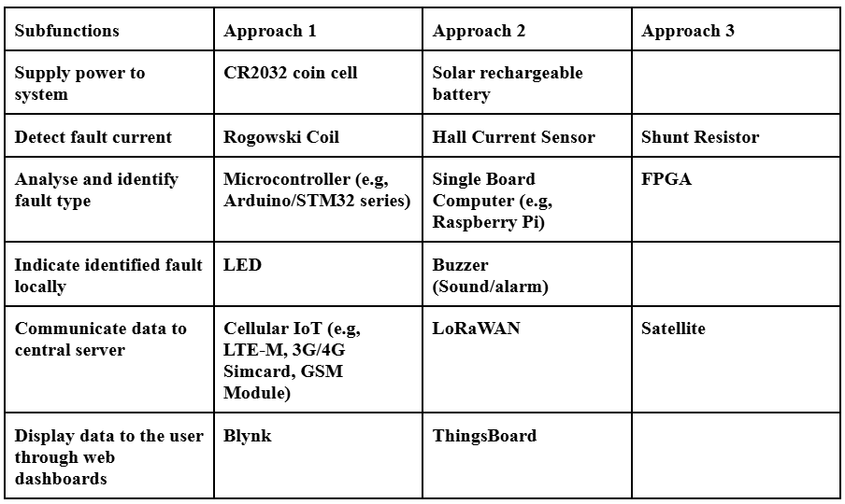
Multiple Design Approaches
Table 1: Proposed 3 design approaches for the project

Slide 15
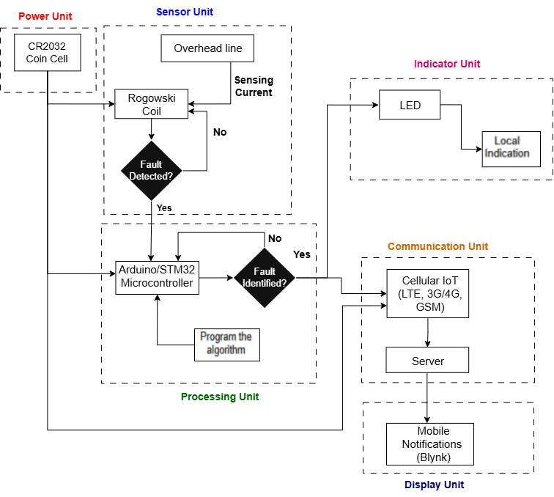
Design Approach 1
Figure 2: Block Diagram of Design Approach 1

Slide 16
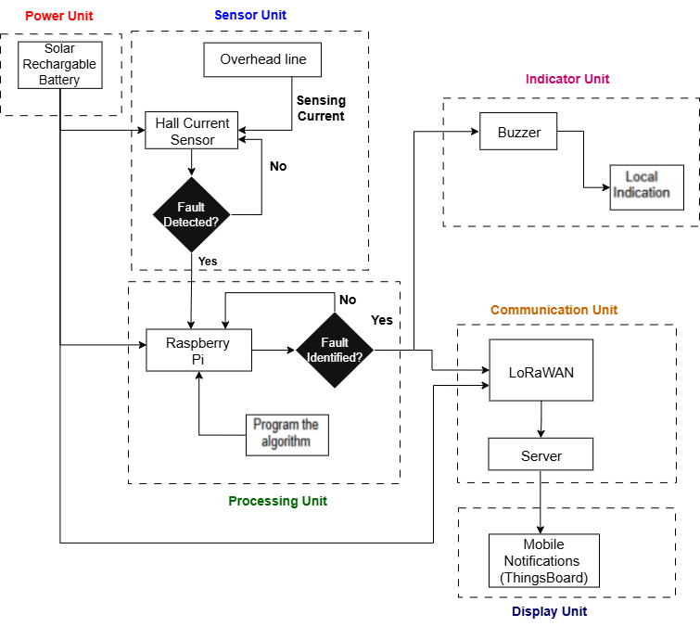
Design Approach 2
Figure 3: Block Diagram of Design Approach 2

Slide 17
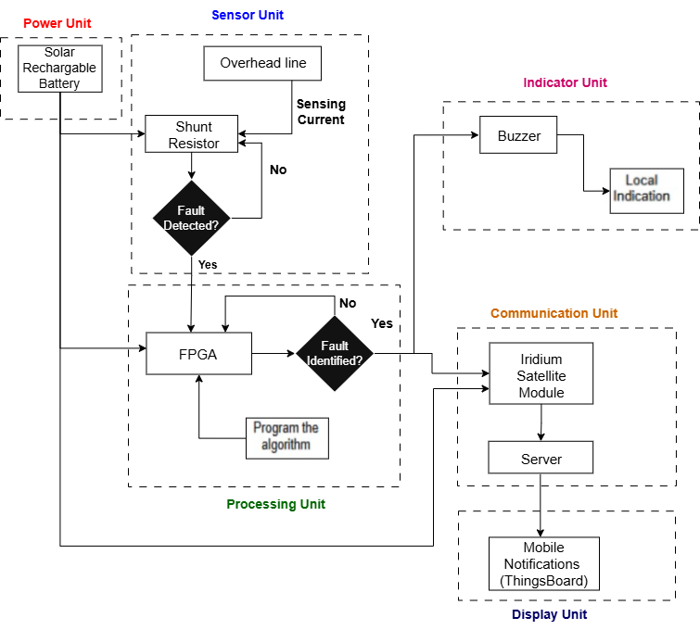
Design Approach 3
Figure 4: Block Diagram of Design Approach 3

Slide 18
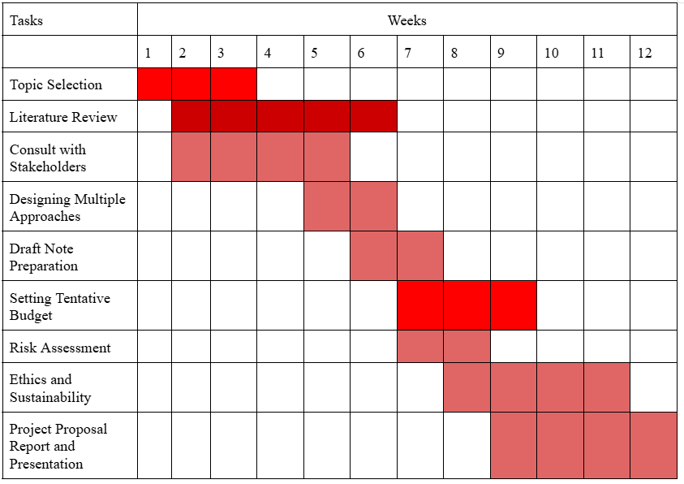
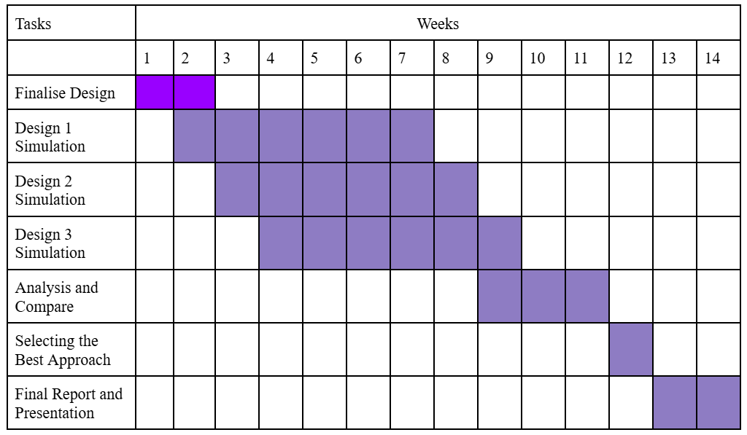
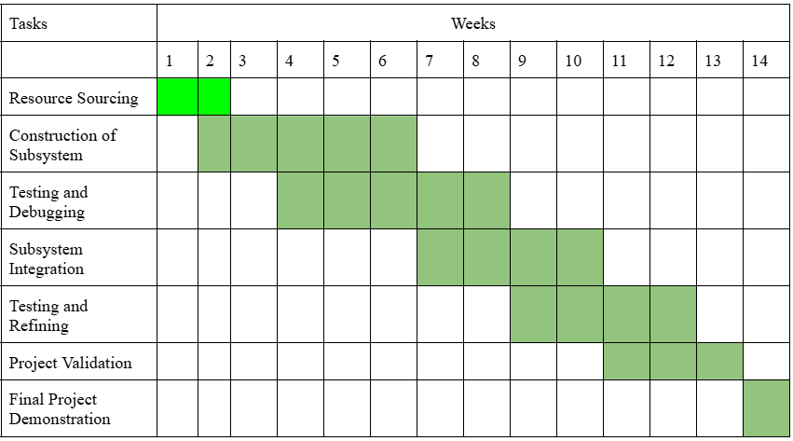
Tentative Gantt Chart
Table-2(a): FYDP-P TIMELINE
Table-2(b): FYDP-D TIMELINE
Table-2(c): FYDP-C TIMELINE

Slide 19
BOM for Design Approach 1
Component Name | Purpose | Unit Price (BDT) | Quantity | Total Price (BDT)
Rogowski Coil | Current measurement for LV lines | 1800 | 2 | 3600
Arduino/STM32 Microcontroller | Device control & fault logic | 850 | 3 | 2550
GSM Module (SIM800L) | Communication with server | 1200 | 2 | 2400
CR2032 Coin Cell | Power supply | 100 | 3 | 300
CR2032 Holder | Battery support | 20 | 2 | 40
Voltage Regulator (LM2596) | Stable system power | 150 | 3 | 450
LED | Local alert system | 120 | 3 | 360
Enclosure (IP55 Plastic) | Outdoor protection | 600 | 2 | 1200
PCB + Wiring + Connectors | Assembly materials | 500 | 3 | 1500
Total Price (Approach 1) |  |  |  | 12400 BDT
Table 3: BOM for Design Approach 1

Slide 20
BOM for Design Approach 2
Component Name | Purpose | Unit Price (BDT) | Quantity | Total Price (BDT)
High-Accuracy Hall Sensor | ±100A measurement | 3200 | 2 | 6400
Raspberry Pi Pico W | On-board analytics & control | 1500 | 3 | 4500
LoRaWAN Module (RFM95W) | Long-range communication | 1900 | 2 | 3800
Li-ion Battery (3.7V, 4000mAh) | Reliable power | 1300 | 2 | 2600
Solar Panel (5W) | Optional charging | 1400 | 1 | 1400
MPPT Charge Controller | Solar/battery management | 1150 | 2 | 2300
Weatherproof Enclosure (IP65) | Outdoor durability | 1000 | 2 | 2000
SD Card 16GB | Local data logging | 900 | 2 | 1800
PCB, Connectors, Fasteners | Assembly materials | 1900 | 3 | 5700
LoRa Antenna Mounting Kit | Better range & installation | 500 | 2 | 1000
Total Price (Approach 2) |  |  |  | 31500 BDT
Table 4: BOM for Design Approach 2

Slide 21
BOM for Design Approach 3
Component Name | Purpose | Unit Price (BDT) | Quantity | Total Price (BDT)
Current Transformer | High-accuracy LV sensing | 3000 | 2 | 6000
Xilinx FPGA Board (Zynq) | High-speed computation | 45000 | 1 | 45000
Satellite/LTE Industrial Modem | Reliable remote communication | 22000 | 1 | 22000
LiFePO₄ Battery (12V, 10Ah) | Long backup | 4500 | 2 | 9000
Solar Panel (20W) | Sustained power supply | 2500 | 2 | 5000
Solar Charge Controller | Battery protection | 650 | 2 | 1300
Industrial IP67 Enclosure | Harsh environment durability | 3500 | 1 | 3500
Heat Sink + Surge Protection | Thermal & surge safety | 1200 | 2 | 2400
PCB, Connectors, Mounts | Assembly accessories | 1500 | 3 | 4500
Total Price (Approach 2) |  |  |  | 98700 BDT
Table 5: BOM for Design Approach 3

Slide 22
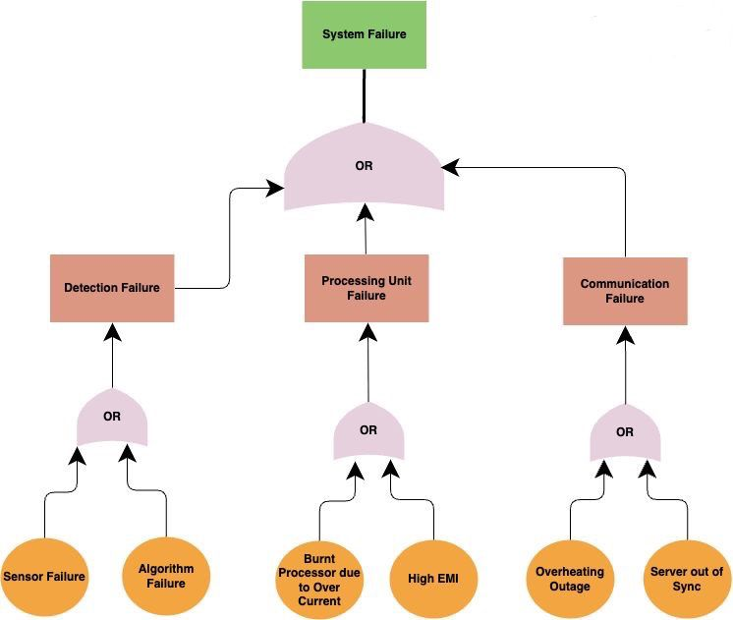
FAULT TREE ANALYSIS
Figure 5: Fault Tree Analysis

Slide 23
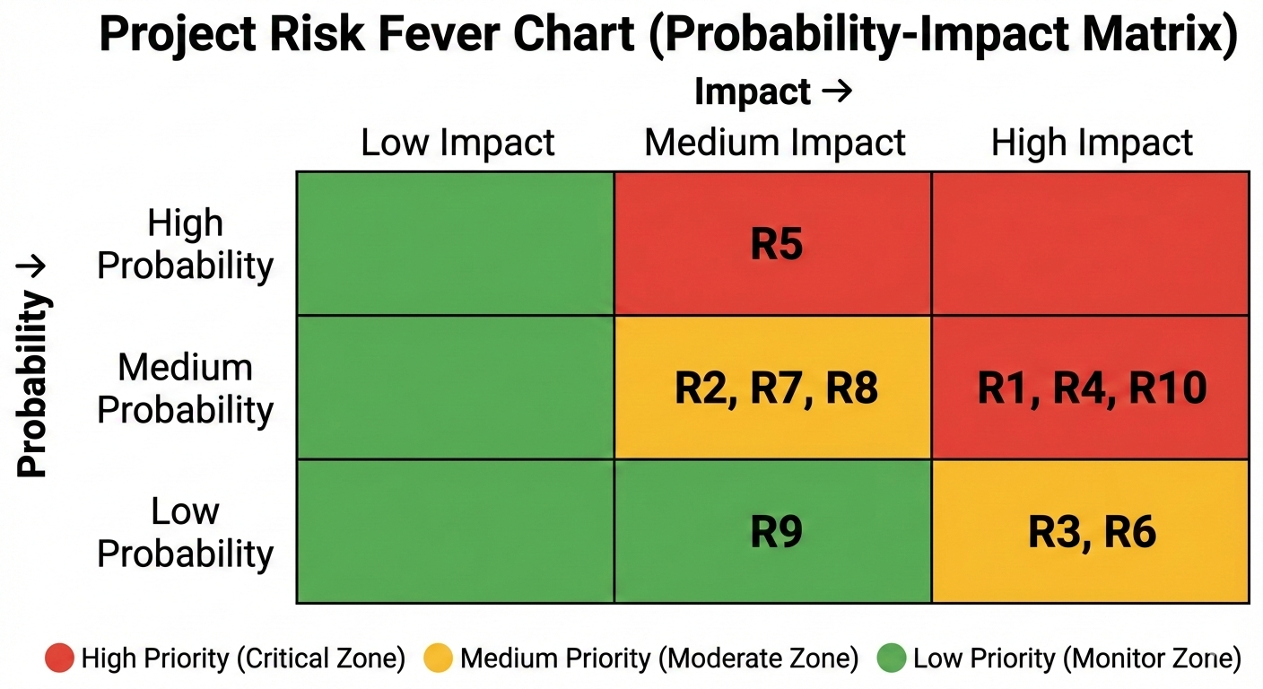
RISK ANALYSIS
Risk ID Legend
R1 — Inaccurate fault detection due to load fluctuations
R2 — Current sensor malfunction
R3 — Communication network failure
R4 — Power supply and battery-related failure
R5 — Environmental and weather-related damage
R6 — Safety hazards during installation and testing
R7 — Hardware integration and compatibility issues
R8 — Component Availability
R9 — Budget Overrun
R10 — Regulatory Approval Delays
Figure 6: Risk Fever Chart

Slide 24
Risk Management Plan
Possible Risk | Mitigation Plan | Contingency
Inaccurate fault detection due to load fluctuations (R1) | • Use multi-parameter fault detection logic • Apply adaptive thresholds and filtering | Adjust detection sensitivity
Current sensor malfunction (R2) | • Use calibrated Hall-effect sensors • Apply noise filtering techniques | Replace faulty sensor
Communication network failure (R3) | • Support multiple communication modes • Implement data buffering | Store data locally
Power supply and battery failure (R4) | • Use low-power components • Monitor battery voltage | Use external power source
Environmental and weather-related damage (R5) | • Use weatherproof enclosure • Proper insulation and grounding | Replace damaged components

Slide 25
Risk Management Plan
Possible Risk | Mitigation Plan | Contingency
Safety hazards during installation and testing (R6) | • Follow safety standards • Use personal protective equipment | Suspend testing immediately
Hardware integration and compatibility issues (R7) | • Modular system design • Subsystem-level testing | Simplify system configuration
Component availability (R8) | • Select locally available parts • Identify alternatives early | Redesign using available components
Budget overrun (R9) | • Prepare budget with buffer • Track expenses regularly | Remove non-essential features
Regulatory approval delays (R10) | • Review standards early • Design per IEEE/IEC codes | Limit work to lab testing

Slide 26
Impact of FPI
Field Technicians & Site Engineers
Rapid fault localization reduces manual patrolling and hazardous exposure
Remote fault information improves response time and maintenance safety
Power Distribution Companies & Utilities
Faster fault detection shortens outages and improves service reliability
Optimized manpower use and reduced maintenance costs
National Grid Management & System Operators
Improved situational awareness enhances grid reliability and resilience
Early fault detection prevents cascading system failures
Users & Society
Reduced outages ensure reliable power for essential services
Improved electricity reliability supports economic and social activities

Slide 27
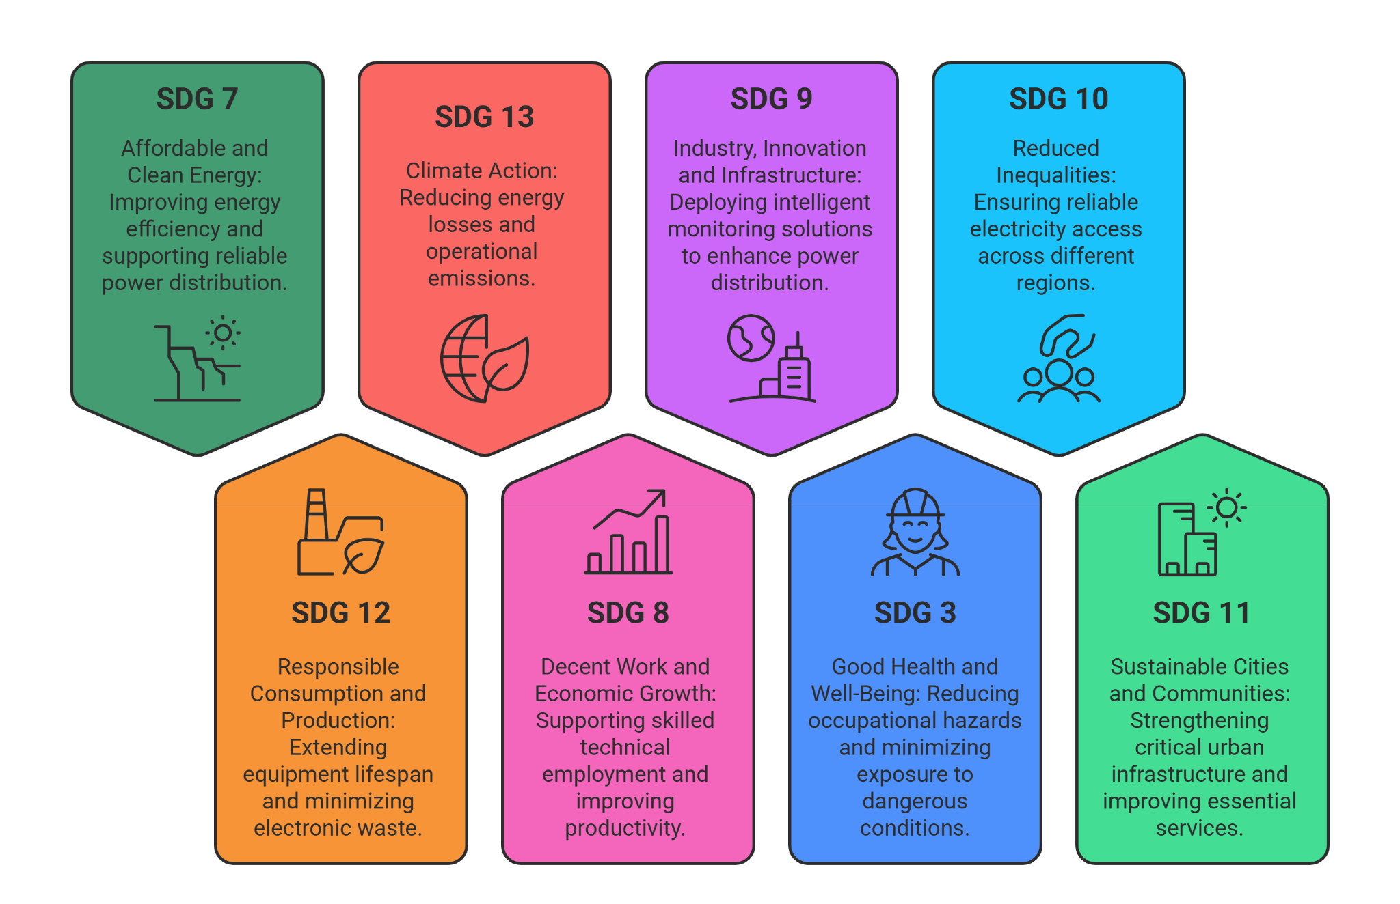
Sustainable Development Goals (SDGs)

Slide 28
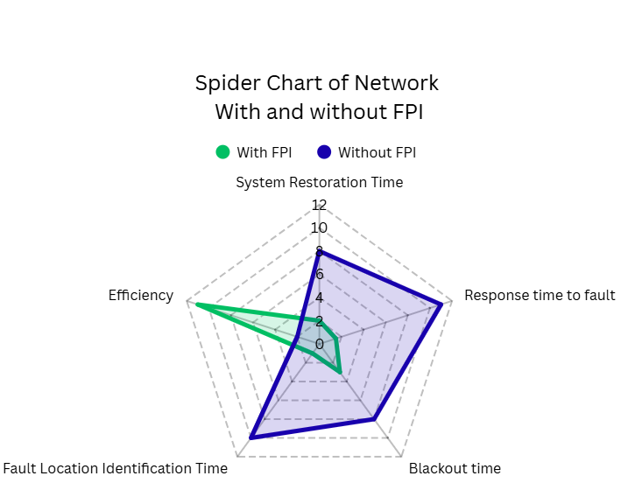
Spider Charts
Figure 7: Spider Chart of the system with and without FPI

Slide 29
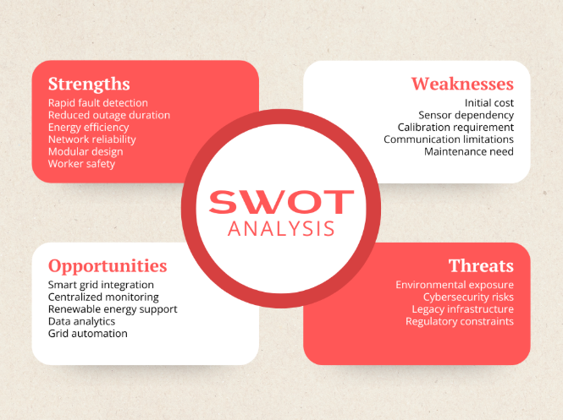
SWOT Analysis
Figure 8: SWOT Analysis

Slide 30
Ethical Considerations
Reliability & Accuracy of Fault Detection
Ensures accurate fault identification to prevent outages, equipment damage, and safety risks
Designed and validated according to IEEE C37.113 and IEEE Std 519 standards
Data Integrity, Confidentiality & Secure Communication
Protects fault data from unauthorized access, tampering, or misuse
Secure communication and access control following IEEE Std 1686 and IEEE 802.1X
Workforce Safety & Responsibility
Remote fault detection reduces exposure to hazardous working conditions
Supports safe work practices aligned with IEEE 1584 arc-flash safety guidelines
Ethical Engineering Practice & Standards Compliance
Compliance with relevant standards ensures interoperability and responsible design
Transparent documentation promotes accountability, safety, and sustainability

Slide 31
Safety Considerations
Electrical Safety
Proper insulation, grounding, and isolation from high-voltage lines
Non-contact current sensing to minimize shock and electrocution risks
Operational Safety
Remote monitoring reduces manual inspection in hazardous areas
Fail-safe system design prevents additional network or personnel risks
Environmental & Equipment Safety
Weatherproof enclosure protects against rain, dust, and humidity
Thermal management and EMC design prevent overheating and interference
Overall System Safety
Compliance with electrical and electromagnetic safety standards
Integrated preventive and protective measures ensure safe, reliable operation

Slide 32
Applicable Standards and Codes
Category | Standard / Code | Description | Relevancy
Power System Protection | IEEE C37.113 | Guide for Protective Relay Applications to Distribution Lines | Widely used reference in Bangladesh for distribution protection logic and fault detection principles
Low-Voltage Distribution & Safety | IEEE 141 (Red Book) | Electric Power Distribution Systems | Used in academic and utility studies for LV distribution behavior
Current Measurement & Sensors | IEEE C57.13 | Instrument Transformer Standards | Provides accuracy and safety guidelines for current measurement
Communication & IoT | IEEE 802.11 | Wireless LAN (Wi-Fi) Standard | Commonly used for local communication and testing
Table-6(a): Applicable Standards and Codes

Slide 33
Applicable Standards and Codes
Category | Standard / Code | Description | Relevance to FPI
Electromagnetic Compatibility (EMC) | IEC 61000-6-2 | EMC Immunity for Industrial Environments | Ensures immunity against EMI in substations and distribution areas
Environmental Protection | IEC 60068 | Environmental Testing | Ensures operation under heat, humidity, and dust conditions
Cybersecurity & Data Integrity | IEEE 1686 | Cyber Security for Intelligent Electronic Devices | Increasingly relevant for smart grid and IoT-based monitoring.
Ethics & Sustainability | UN SDGs (7, 9, 11) | Sustainable Development Goals | Aligns with Bangladesh’s national energy and infrastructure goals
Table-6(b): Applicable Standards and Codes

Slide 34
Future Implications
The developed smart communicable FPI system can be scaled and implemented for 11 kV medium-voltage distribution networks to enhance fault localization and feeder monitoring.
Advanced data analytics and machine learning techniques can improve fault detection accuracy and enable predictive maintenance in future prospects.
Integration with SCADA and distribution automation systems can support automated fault isolation and faster service restoration.

Slide 35
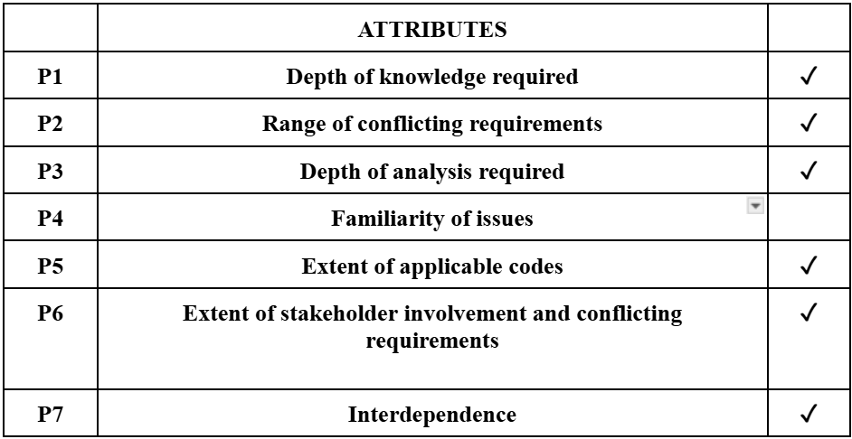
Attributes of Complex Engineering Problems (EP)

Slide 36
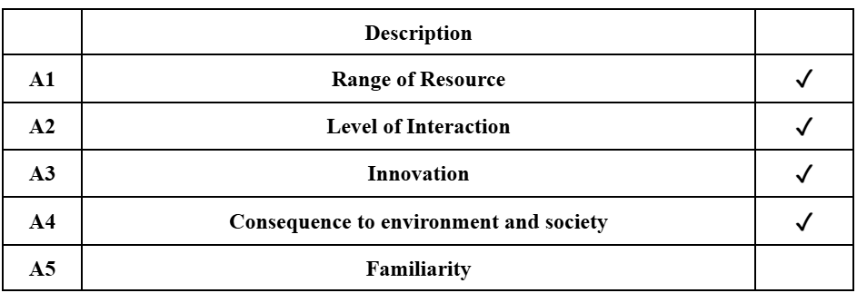
Attributes of Complex Engineering Activities (EA)

Slide 37
References:
[1] S. H. Asman, N. F. A. Aziz, U. A. U. Amirulddin, and M. Z. A. A. Kadir, “Transient Fault Detection and location in power Distribution Network: A review of current practices and challenges in Malaysia,” Energies, vol. 14, no. 11, p. 2988, May 2021, doi: 10.3390/en14112988.
[2] S. Ali, M. Yongzhi, and W. Ali, “Prevention and detection of electricity theft of distribution network,” Sustainability, vol. 15, no. 6, p. 4868, Mar. 2023, doi: 10.3390/su15064868.
[3] K. Mahmud and A. K. M. M. Haque, “Power Scenario of Bangladesh and Schemes of Sustainable Optimal Reduction in the Power System Loss,” Global Journal of Research in Engineering, vol. 12, Sep. 2012, [Online].
[4] M. Habib and N. Taylor, “Incremental phase-current based fault passage indication for earth faults in resonant earthed networks,” Electricity, vol. 4, no. 2, pp. 197–214, 2023, doi: 10.3390/electricity4020007.
[5] B. Olejnik, “Adaptive zero-sequence overcurrent criterion for earth fault detection for fault current passage indicators in resistor grounded medium voltage networks,” IEEE Access, vol. 9, pp. 63952–63965, 2021, doi: 10.1109/ACCESS.2021.3076022.
[6] T. Jain, D. Ghosh, and D. Mohanta, “Augmentation of situational awareness by fault passage indicators in distribution network incorporating network reconfiguration,” Protection and Control of Modern Power Systems, vol. 4, no. 1, pp. 1–14, 2019, doi: 10.1186/s41601-019-0140-6.
[7] B. Olejnik and B. Zięba, “Improving the efficiency of earth fault detection by fault current passage indicators in medium-voltage compensated overhead networks,” Energies, vol. 15, no. 23, pp. 1–20, 2022, doi: 10.3390/en15239007.
[8] A. Farughian, L. Kumpulainen, K. Kauhaniemi, S. Pettissalo, and V. Sallinen, “Technical requirements for practical implementation of fault passage indication,” in Proc. IEEE PES Innovative Smart Grid Technologies Europe (ISGT Europe), 2021, pp. 1–6, doi: 10.1109/ISGTEurope52324.2021.9640016.

Slide 38
[9] J. Altonen, A. Wahlroos, and S. Vähäkuopus, “Application of multi-frequency admittance-based fault passage indication in practical compensated medium-voltage network,” in Proc. CIRED, 2017, pp. 947–951, doi: 10.1049/oap-cired.2017.0967.
[10] J. Altonen and A. Wahlroos, “Performance of modern fault passage indicator concept in compensated medium-voltage networks,” in Proc. IET Conference Publications, vol. 686, 2016, pp. 538–542, doi: 10.1049/cp.2016.0733.
[11] M. Yadav, P. Verma, and D. Saini, “Fault detection in overhead lines using IoT-enabled fault passage indicator,” in Advances in Intelligent Systems and Computing, 2021, pp. 259–268, doi: 10.1007/978-981-16-1510-8_25.
[12] S. Vyavahare and A. Thosar, “Fault passage indicator for medium voltage lines using fuzzy inference system,” in Proc. Asian Conf. on Intelligent Technologies (ACOIT), 2024, pp. 1–4, doi: 10.1109/ACOIT62457.2024.10939914.
[13] A. Farughian, L. Kumpulainen, K. Kauhaniemi, and P. Hovila, “Intermittent earth fault passage indication in compensated distribution networks,” IEEE Access, vol. 9, pp. 45356–45366, 2021, doi: 10.1109/ACCESS.2021.3067497.
[14] A. Farughian, L. Kumpulainen, and K. Kauhaniemi, “Non-directional earth fault passage indication in isolated neutral distribution networks,” Energies, vol. 13, no. 18, pp. 1–18, 2020, doi: 10.3390/en13184732.
[15] S. Zubic and Z. Gajić, “Current-only fault passage indicator for high impedance grounded networks,” in Proc. 17th Int. Conf. on Developments in Power System Protection (DPSP), 2024, doi: 10.1049/icp.2024.1022.
[16] A. C., R. K., G. C., and A. V., “Advanced overhead field passage indicator for high-current power lines,” in Proc. 3rd Int. Conf. on Smart Systems for Applications in Electrical Sciences (ICSSES), 2025, pp. 1–6, doi: 10.1109/ICSSES64899.2025.11009400.
[17] T. Sangwan and D. Kumar, “Use of Python, MATLAB, and R for developing artificial neural network for identification of fault type in overhead transmission lines,” International Journal of Engineering Applied Sciences and Technology, vol. 7, no. 6, pp. 98–104, 2022, doi: 10.33564/IJEAST.2022.v07i06.015.
[18] A. Recioui, M. Merdj, and A. Kamli, “Optimal placement of fault passage indicators in distribution networks using genetic algorithms,” Algerian Journal of Signals and Systems, vol. 6, no. 4, pp. 1–10, 2021, doi: 10.51485/AJSS.v6i4.139.

Slide 39
Thank You!

